Slide 1
Chapter 6
Section 6.1-6.2

Slide 2

Programmer-Defined Functions
Two components of a function definition
Function declaration (or function prototype)
Shows how the function is called
Must appear in the code before function can be called
Syntax: Type_returned Function_Name(Parameter_List); // comment describing what function does
Function definition
Describes how the function does its task
Can appear before or after the function is called
Syntax: Type_returned Function_Name(Parameter_List) { // code to make the function work }

Slide 3
Function Declaration
Tells the return type
Tells the name of the function
Tells how many arguments are needed
Tells the types of the arguments
Tells the formal parameter names
Formal parameters are like placeholders for the actual arguments used when the function is called
Formal parameter names can be any valid identifier
Example: double total_cost(int number_par, double price_par); // compute total cost including 5% sales tax on // number_par items at cost of price_par each

Slide 4
Function Definition
Provides the same information as the declaration
Describes how the function does its task
Example:
double total_cost(int number_par, double price_par) { const double TAX_RATE = 0.05; //5% tax double subtotal; subtotal = price_par * number_par; return (subtotal + subtotal * TAX_RATE); }
function header
function body

Slide 5
The return Statement
Ends the function call
Returns the value calculated by the function
Syntax: return expression;
expression performs the calculation or
expression is a variable containing the calculated value
Example: return subtotal + subtotal * TAX_RATE;

Slide 6
The Function Call
Tells the name of the function to use
Lists the arguments
Is used in a statement where the returned value makes sense
Example: double bill = total_cost(number, price);
What can we tell about this function?

Slide 7
Order of Arguments
Compiler checks that the types of the arguments are correct and in the correct sequence
Compiler cannot check that arguments are in the correct logical order
Example: Given the function declaration:
char grade(int received_par, int min_score_par); …
int received = 95, min_score = 60; …
cout << grade(min_score, received);
Produces a faulty result because the arguments are not in the correct logical order. The compiler will not catch this!

Slide 8
Placing Definitions
A function call must be preceded by either
The function’s declaration or
The function’s definition
If the function’s definition precedes the call, a declaration is not needed
Placing the function declaration prior to the main function and the function definition after the main function leads naturally to building your own libraries in the future

Slide 9
Placing Definitions
Typically:
int test(int x); // function declaration
...
int main()
{
...
int val = test(5); // function call
...
}
...
int test(int x) // function definition
{
...
}

Slide 10
Chapter 6
Section 6.3

Slide 11
Top-Down Design
To write a program
Develop the algorithm that the program will use
Translate the algorithm into the programming language
Top Down Design (also called stepwise refinement)
Break the algorithm into subtasks
Break each subtask into smaller subtasks
Eventually the smaller subtasks are trivial to implement in the programming language

Slide 12
Benefits of Top-Down Design
Subtasks, or functions in C++, make programs
Easier to understand
Easier to change
Easier to write
Easier to test
Easier to debug
Easier for teams to develop

Slide 13
Chapter 6
Section 6.4

Slide 14
Functions with Branches/Loops
Just like your main() function has branches and loops, your programmer-defined functions also have them
See Zybooks Section 6.5 and demo programs for examples

Slide 15
Chapter 6
Section 6.7

Slide 16
Common Errors
Copy-pasted codes
Wrong return type
Missing return statement
Passing wrong parameters
Wrong Values
Wrong Datatype
Wrong Order

Slide 17
Chapter 6
Section 6.8

Slide 18
Local Variables
Variables declared inside a function:
Are local to that function, they cannot be used from outside the function
Have the function as their scope
Variables declared in the main part of a program:
Are local to the main part of the program, they cannot be used from outside the main part
Have the main part as their scope

Slide 19
Global Constants
Global Named Constant
Available to more than one function as well as the main part of the program
Declared outside any function body
Declared outside the main function body
Declared before any function that uses it
Example: const double PI = 3.14159; double volume(double); int main() { … }
PI is available to functions main and volume

Slide 20
Global Variables
Global Variable
Rarely used when more than one function must use a common variable
Unless explicitly allowed in an assignment, you should not use global variables
Declared just like a global constant except const is not used
Generally make programs more difficult to understand and maintain

Slide 21
Formal Parameters are Local Variables
Formal Parameters are actually variables that are local to the function definition
They are used just as if they were declared in the function body
Do NOT re-declare the formal parameters in the function body as they are already declared in the function declaration
The call-by-value mechanism
When a function is called, the formal parameters are initialized to the values of the arguments in the function call

Slide 22
Block Scope
Local and global variables conform to the rules of Block Scope
The code block, generally defined by the { … }, where an identifier like a variable is declared determines the scope of the identifier
Blocks can be nested

Slide 23
Pass by value or Pass by reference
Remember, you don’t actually pass a variable to a function, you provide the value contained inside the variable to the function– hence, pass by value
Pass by value
Separate local copy of the passed value created as a local variable
Local variable resides somewhere else in memory compared to the variable “passed”
Changes made to the variable are hence local
Pass by reference
You are not passing a value of the variable but rather the reference of the variable– which is the address of the variable
The so-called local variable is now residing in the same location as the original variable
Changes are no longer local

Slide 24
Chapter 6
Section 6.9-6.10

Slide 25
Arrays in Functions
Indexed variables can be arguments to functions
Example:
If a program contains these declarations:
int i, n, a[10]; void my_function(int n);
Variables a[0] through a[9] are of type int, making these calls legal: my_function( a[ 0 ] ); my_function( a[ 3 ] ); my_function( a[ i ] );

Slide 26
Array as Function Arguments
A formal parameter can be for an entire array
Such a parameter is called an array parameter
It is not a call-by-value parameter
It is not a call-by-reference parameter
Array parameters behave much like call-by-reference parameters

Slide 27
Array Parameter Declaration
An array parameter is indicated using empty brackets in the parameter list such as void fill_up(int a[ ], int size);

Slide 28
Function Calls with Arrays
If function fill_up is declared in this way: void fill_up(int a[ ], int size);
and array score is declared this way: int score[5], number_of_scores;
fill_up is called in this way: fill_up(score, number_of_scores);

Slide 29
Function Call Details
A formal parameter is identified as an array parameter by the [ ]'s with no index expression void fill_up(int a[ ], int size);
An array argument does not use the [ ]'s fill_up(score, number_of_scores);

Slide 30
Array Formal Parameters
An array formal parameter is a placeholder for the argument
When an array is an argument in a function call, an action performed on the array parameter is performed on the array argument
The values of the indexed variables can be changed by the function

Slide 31
Array Argument Details
What does the computer know about an array?
The base type
The address of the first indexed variable
The number of indexed variables
What does a function know about an array argument?
The base type
The address of the first indexed variable

Slide 32
const Modifier
Array parameters allow a function to change the values stored in the array argument
If a function should not change the values of the array argument, use the modifier const
An array parameter modified with const is a constant array parameter
Example: void show_the_world(const int a[ ], int size);

Slide 33
Using const with Arrays
If const is used to modify an array parameter:
const is used in both the function declaration and definition to modify the array parameter
The compiler will issue an error if you write code that changes the values stored in the array parameter

Slide 34
Function Calls and const
If a function with a constant array parameter calls another function using the const array parameter as an argument…
The called function must use a constant array parameter as a placeholder for the array
The compiler will issue an error if a function is called that does not have a const array parameter to accept the array argument

Slide 35
const Parameters Example
double compute_average( int a[ ], int size);
…
void show_difference(const int a[ ], int size) { double average = compute_average(a, size); … }
compute_average has no constant array parameter
This code generates an error message because compute_average could change the array parameter
needs the const modifier here

Slide 36
Returning an Array
Recall that functions can return a value of type int, double, char, …, or a class type
But… functions cannot return arrays
Remember that even though we cannot return an array, we can still modify the values of an array
We learn later how to return a pointer to an array

Slide 37
Common Errors
Don’t providing the size of an array during function call
Incorrectly/Unnecessarily modifying arrays

Slide 38
Chapter 6
Section 6.12

Slide 39
Default Parameters
The number of arguments in function call can be less than function definition—provided the formal parameters in function parameters have default values.
Check demonstration program
When some formal parameters have default values and others do not
All formal parameters with default values must be at the end of the parameter list
Arguments are applied to the all formal parameters in order just as we have seen before
The function call must provide at least as many arguments as there are parameters without default values

Slide 40
Chapter 6
Section 6.14-6.16

Slide 41
Multiple File C++ Programs
C++ allows you to divide a program into parts
Each part can be stored in a separate file
Each part can be compiled separately
Each individual compilation is fast
Separately compiled code is linked to produce the executable
While we’re not working explicitly with class definitions yet, it will become useful as you start to define and work with your own classes
Class definition can be stored separately from program
This allows you to use the class in multiple programs

Slide 42
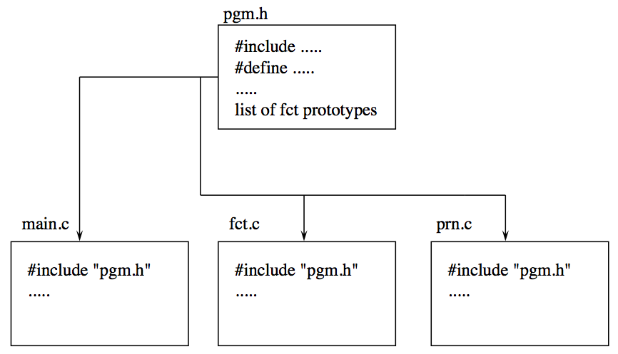
Developing a Large Program
Usually developed by several teams
Made up of many .h and .cpp files
The .h suffix means this is a header file
Each .cpp file can be compiled separately
We compile the program with the command
g++ –o pgm main.cpp fct.cpp prn.cpp
The compiler makes the executable file pgm along with three .o files that correspond to the .cpp files
main.cpp
fct.cpp
prn.cpp

Slide 43
Include Directives
To include a predefined header file, use < … >
The < … > tells the compiler to look where the system stores predefined header files
#include <iostream>
To include a header file that you wrote, use " … "
The “ … ” usually tells the compiler to look in the current directory for the header file
#include "pgm.h"

Slide 44
Separate Compilation
The header file is not compiled separately
The preprocessor replaces any occurrence of #include "pgm.h" with the text of pgm.h before compiling
The implementation files that use the header file must contain #include "pgm.h"
The text of pgm.h is seen by the compiler in each of these files
There is no need to compile pgm.h separately

Slide 45
Developing a Large Program
Suppose we have the following:
Header file f.h contains the function prototypes
The implementation files f1.cpp, f2.cpp, and f3.cpp contain the function definitions
Each .cpp file must use an include directive to include the header file: #include “f.h”
We can compile using the following:
g++ f1.cpp f2.cpp f3.cpp
Program executable will be stored in a.out

Slide 46
Developing a Large Program
Given the following files, how would we compile?
Assume our executable is a.out
g++ main.cpp min.cpp
#include <iostream>
int min2(int a, int b);
int min3(int a, int b, int c);
min.h
#include “min.h”
int main( )
{
cout << min3(1,3,4) << endl;
return 0;
}
main.cpp
#include “min.h”
int min2(int a, int b)
{
if (a<b) return a;
else return b;
}
int min3(int a, int b, int c)
{
int mofab = min2(a,b);
return min2(mofab, c);
}
min.cpp

